Slide 1

Date-A-Scientist Capstone Project
Machine Learning Fundamentals Kevin Sullivan
18 July 2020

Slide 2
Table of Contents
Exploration of the Dataset
Classification Question to Answer
Classification Approaches
Regression Questions to Answer
Regression Approaches
Conclusions/Next steps

Slide 3
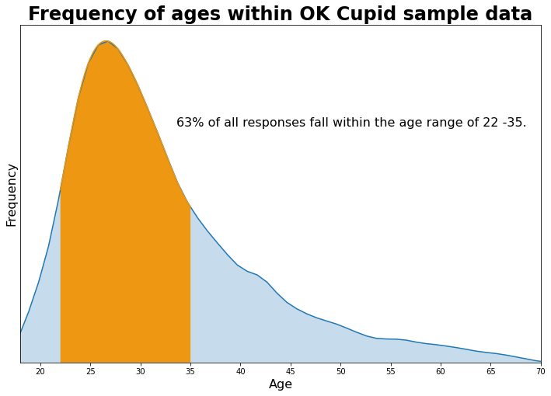

Age Distribution Within Dataset
Taking a look at the data we can look first into the age range
Using a probability distribution of the data we can determine that 62.9% of users fall between the age ranges of 22-35 indicating that this dataset skews very strongly toward young adults
The max listed age is 110, but beyond age 70, there are very few responses

Slide 4
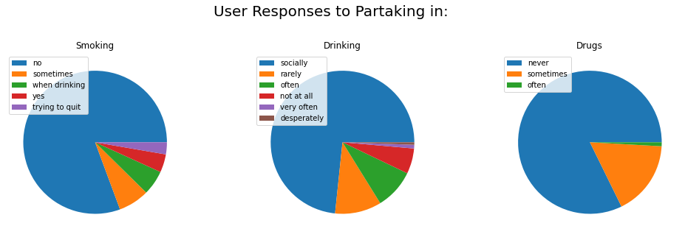
Attributes of the Dataset
We’ll use the data for responses about smoking, drinking and drugs as part of our classification so what are the actually responses.? These data are placed on a numeric scale starting from 0 for not partaking in order to be able to enter a classification algorithm

Slide 5
Attributes of the Dataset
Long Form Essays
The responses also include long form essay responses to various personal questions.
In order to analyze these responses we should clean the data after merging all responses together in order to:
Place all words as lowercase
Remove HTML tags included in the responses
Remove punctuation
From this we will make columns for:
Total length of essay
Average word length
The number of times “I” or “me” appears divided by total number of words

Slide 6
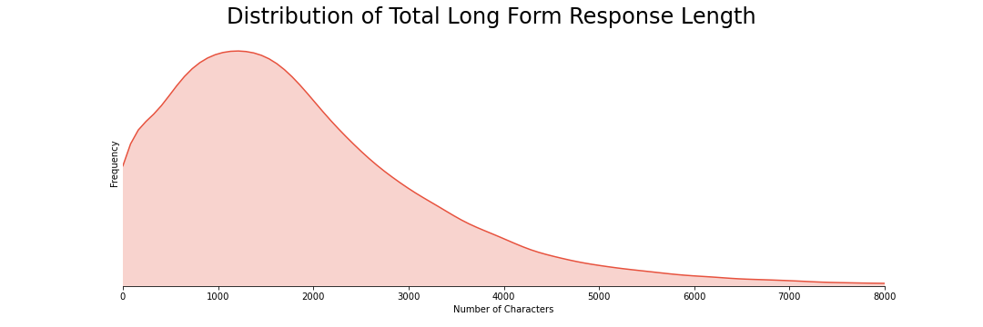
Attributes of the Dataset

Slide 7
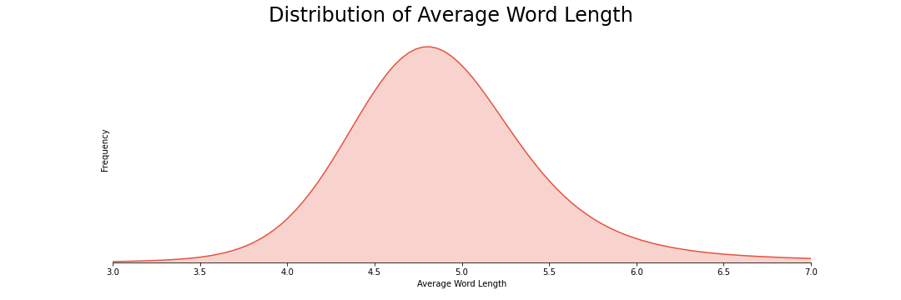
Attributes of the Dataset
Note: There is a large peak at 0 from empty responses

Slide 8
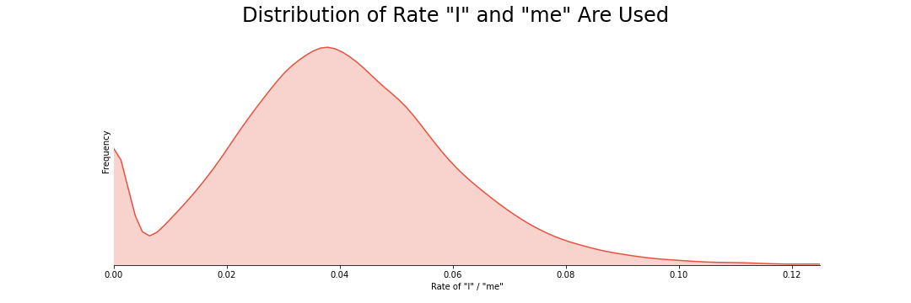
Attributes of the Dataset

Slide 9
Normalizing the Dataset
The data were normalized using a StandardScalar object from Scikit Learn.
This was used over MinMax due to the presence of many extreme outliers in the essay responses
The first 5 normalized responses are shown below
 | smokes_code | drinks_code | drugs_code | essay_len | avg_word_length | rate_of_i_me
0 | 1.5516 | 0.192311 | -0.457207 | 0.221055 | -0.031698 | -0.05142
1 | -0.42115 | 1.537983 | 1.956334 | -0.370349 | -0.248504 | 1.446319
2 | -0.42115 | 0.192311 | -0.457207 | -0.775603 | 0.482377 | -0.806581
3 | -0.42115 | 0.192311 | -0.457207 | -0.473252 | 0.848358 | -0.930372
4 | -0.42115 | -2.499033 | -0.457207 | 0.071903 | 0.018382 | 1.140107

Slide 10
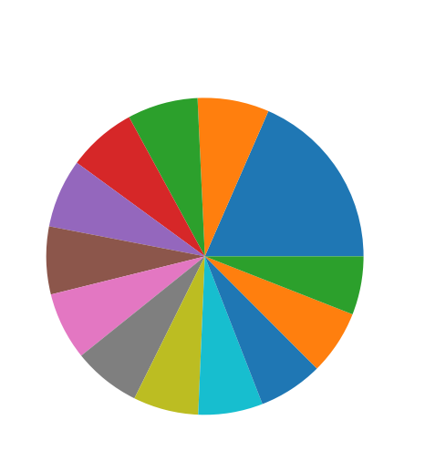
Analyzing the Question
We will look to see how predictive our existing traits are for Zodiac symbols
Let’s look at the responses to the zodiac sign.
With 13 responses, random chance should be 7.7% accurate

Slide 11
Classification Results
Obviously there’s nothing to astrology so it’s got to be close to random chance.
So….what did we find?

Slide 12
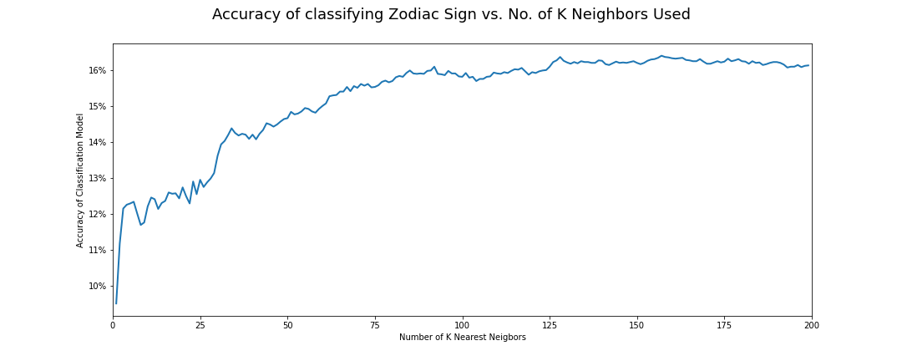
Classification Results

Slide 13
Classification Results
Did we just prove there’s something to Astrology?
Well….not yet. We should come up with a few alternative explanations.
People may adjust their responses to fit their sign
There is probably a huge correlation with no response on the essays and no response for zodiac sign
That second explanation seems much more probable and our classifier can just say no answer for one means no answer for another. Let’s test it out by removing the rows with “No Answer” from our zodiac sign list.
We don’t want to remove empty essays because that still could be a hint for zodiac signs

Slide 14
Classification Results
Sooooo…..
Let’s re-run the data!
Remember that now with 12 possible responses, the accuracy to beat is 8.3%

Slide 15
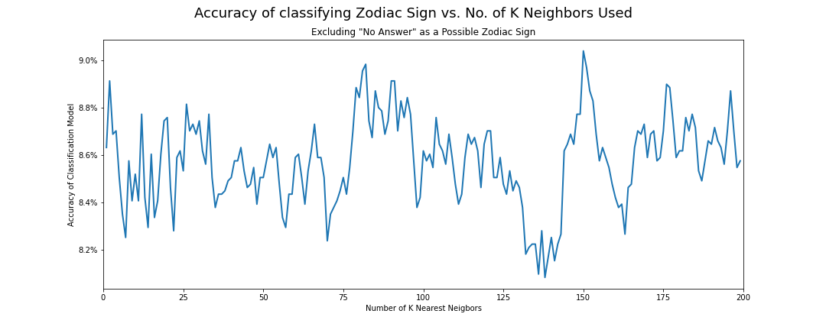
Classification Results
Notes:
Remember random chance was 8.3% so we did very slightly beat it

Slide 16
Classification Results
It looks like our classification did beat random chance…
Just not by much.
The number of neighbors doesn’t appear to affect the accuracy much and our mean was 8.6%
If we assume each score value is independent, we can determine that it is indeed statistically significantly higher than random chance*
This is a very slight if real result so our other hypothesis may be valid that people may choose responses they think are fitting. * resulting p-value was 5.5 x 10⁻⁴⁶

Slide 17
Regression Questions
We will also see how well we can evaluate the following questions using regression analysis:
Can we predict income with length of essays and average word length?
Can we predict age with the prevalence of “I” or “me” in an essay
Let’s get started!

Slide 18
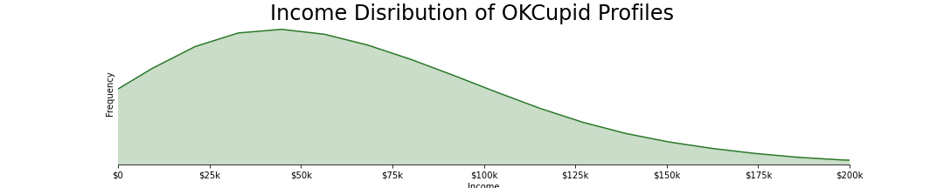
Regression Preparation
Upon looking at the income data we can see that a value of -1 corresponds to no answer so we remove all of those rows.
Unfortunately for our analysis only 19.2% of respondents have a valid response
The distribution may be seen below:
*Note: There is also a peak of people reporting income of $1,000,000

Slide 19
Regression Preparation
We can imagine there might be some selection bias in who is choosing to place their income as well as the possibility that people may be lying to inflate their income.
The asterisk in the graph noted that there is a peak around $1,000,000 that seems very unnatural in a true distribution
Fortunately, we don’t care about the “Real” distribution since we only want to compare within the dataset.
Time to model!

Slide 20
Regression Analysis
We will use standard linear regression and K nearest neighbors regression to see how well the data fit our questions.
On the standard linear regression model we get the following results for our two questions
K Neighbors Regression returned an R² value of -0.0144
 | Impact of essay length on income (char/$) | Impact of average word length on income (char/$) | R² value of fit
Standard Linear Regression | -2.19 | 10100 | -0.00306

Slide 21
Regression Analysis
Time to move on to asking about Age
With a standard linear regression model we get a coefficient of -16.8 meaning that for a rate difference of 10% more (e.g. from overall 5% to 15%) we get would expect age to decrease by 1.6 years.
Considering our data range is almost entirely under 10% this doesn’t make much sense.
Indeed the R² value is .000875.
Using our K nearest Neighbors approach the R² value is -0.0117

Slide 22
Regression Conclusion
Our data appears to not be very useful for linear regression as all of our methods resulted in a very poor fit.

Slide 23
Thank You For Your Time
GOOD LUCK AND HAVE FUN!

